Slide 1
Player Controls
Move the boat with the directional keys and interact with things using the action button.
W
↑
A
S
D
←
↓
→
␣
🖯
Player 2
Player 1

Slide 2
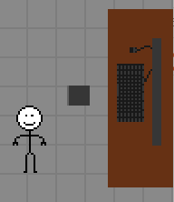

Mission Hub
You can only leave the Hub once you have picked a mission. Walk to the computer desk to select a mission or gameplay mode.

Slide 3


Objective
Find the people in danger at sea! Interact with them to initiate a microgame. Upon successful completion, the rescue is complete and the score increases by 1.

Slide 4
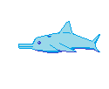

Bonus
Find friendly wildlife for bonus points. In 2 Player mode, both players must battle for it in a tug of war.

Slide 5


Hazards
Stay away from sharks and sea monsters! They will send you flying off in unpredictable directions at high speed.

